Slide 1
CIS 271 – Web Development 1
JavaScript Functions & Basic DOM

Slide 2
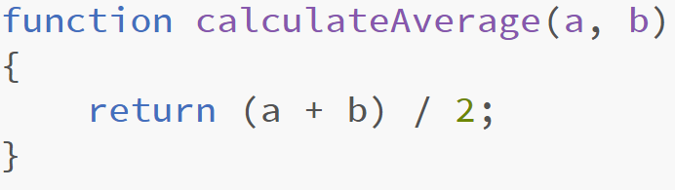
JavaScript Functions
Function
  A named group of statements
  Stores the steps needed to achieve a task
Function Call
  A request made by the script
  Performs a previously written function

Slide 3
Named Functions
Named Function (Function Declaration)
  Declared with the function keyword
  Functions may take any number of parameters
  May return a single value using the return statement
    Without a return, a function returns undefined
  Interpreters always look declarations before going through a script (Hoisting)
    We can call this function before declaring it

Slide 4
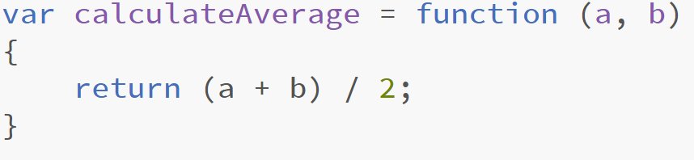
Function Expression
Function expression
  Function name is omitted
    Anonymous function
  Not processed until the interpreter gets to that statement
  Code that appears before this expression, could affect the contents of the function!
  A function call before this expression will cause an exception error

Slide 5
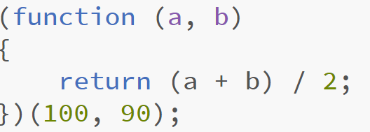
Anonymous Function
Anonymous Function
  a function that does not have a name.
  normally assigned to a variable so the function can be called
  an anonymous function can call itself when the anonymous function is declared
    Self-invoking function

Slide 6
Arrow Function
Arrow Function
  An anonymous function that uses an arrow =>
  Does not require the keyword function
  Arrows represents return
  Creates a compact function

Slide 7
Variable Scope
Local Variable
Global Variable
When a variable is created inside a function using the var keyword, it can only be used in that function.
It cannot be accessed outside of the function in which it was declared.
  If the function runs twice, the variable can have different values each time.
  Two different functions can use variables with the same name without any kind of naming conflict.
If you create a variable outside of a function, then it can be used anywhere within the script.
Global variables are stored in memory for as long as the web page is loaded into the web browser.
If you forget to declare a variable using the var keyword, the variable will work, but it will be treated as a global variable

Slide 8
Variable Scope
Block Scope
A variable declared inside a function with the let keyword
The variable is accessible only within the enclosing pair of curly braces.

Slide 9
Global Object
Before code is run, JavaScript implementations create the global object
Global Object
  an object that stores certain global variables, functions, and other properties
When running JavaScript code in a web browser,
  global variables are usually assigned as properties to the global window object.
Developers must be careful when assigning global variables, because a global variable could replace an existing window property.

Slide 10
DOM – Document Object Model
Document Object Model (DOM)
  a data structure corresponding to the HTML document displayed in a web browser.
  A DOM tree is a visualization of the DOM data structure
  Each tag in an HTML document is associated with an object in the DOM tree
  A node is an individual object in the DOM tree.

Slide 11
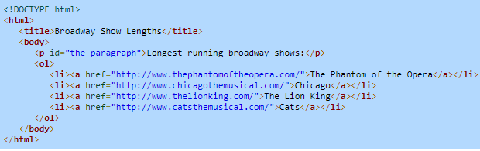
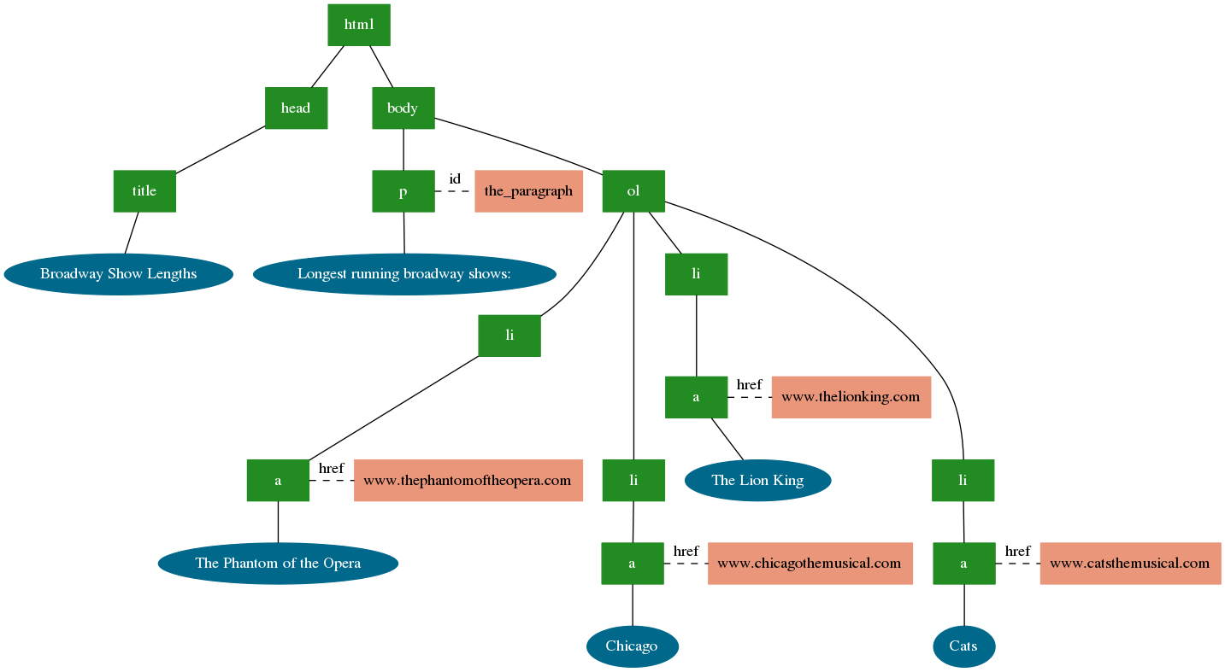

Slide 12
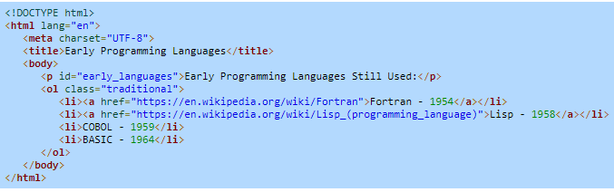
Traversing the DOM
The document object provides five primary methods of accessing specific nodes within the DOM:
For now, we will take a look at one method:
  document.getElementById()
    Returns the DOM node whose id attribute is the same as the method's parameter.
What would be returned by the code:
document.getElementById("early_languages");

Slide 13
Modifying DOM node attributes
Every attribute for an HTML element has an identically named property in the element's DOM node.
For example:
<a href="http://www.nasa.gov/" id="nasa_link">NASA</a>
has a corresponding DOM node with properties named href and id. Each attribute property name acts as both a getter and a setter.
We can access properties as follow:
document.getElementById("nasa_link").href = "http://www.spacex.com/"
changes the hyperlink for the element with id of nasa_link to refer to SpaceX.

Slide 14
Modifying DOM node attributes
We can modify the text within any tag by utilizing the textContent property
For example:
document.getElementById("myParagraph").textContent = "Hello, JS!";
Would modify the element with id myParagraph so that its text becomes “Hello, JS!”

